Slide 1
Neural Networks Introduction
Prof. Dr. Umberto Michelucci
umberto.michelucci@toelt.ai
umberto.Michelucci@hslu.ch

Slide 2
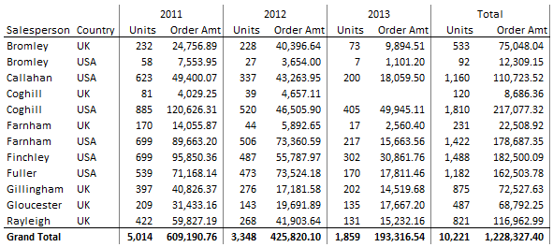
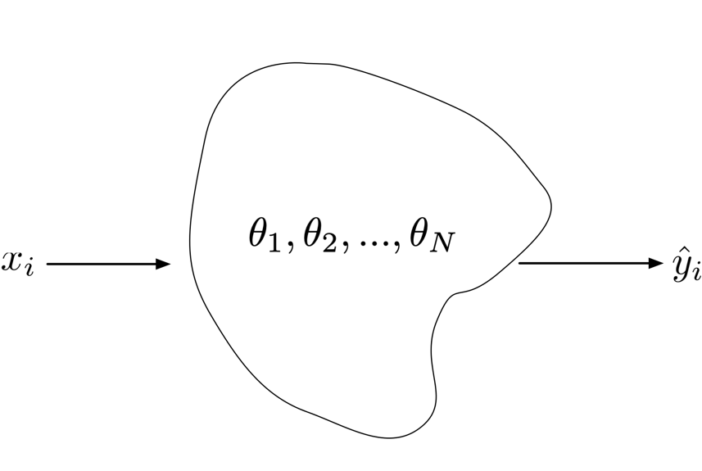
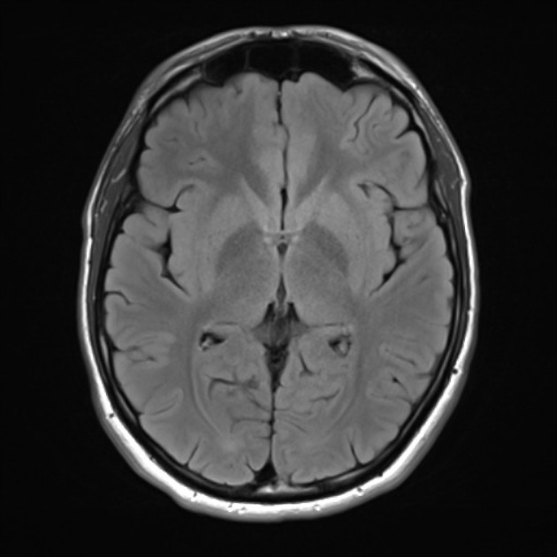
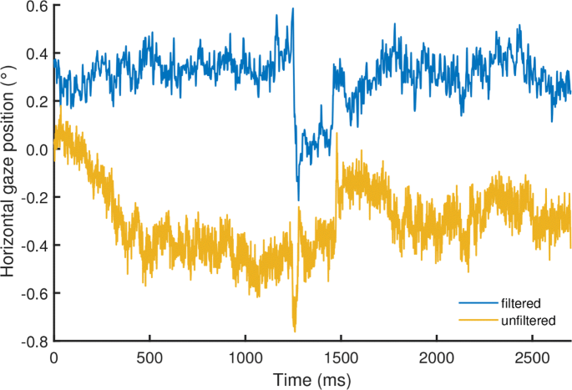
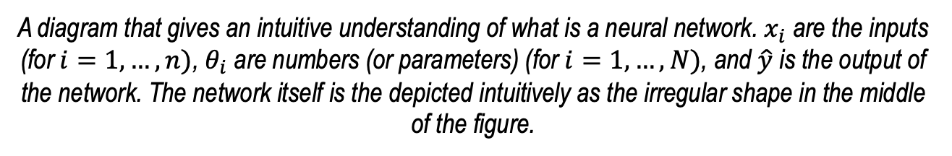
An intuitive understanding of a neural network
Class 1,
Class 2,
Class 3,
Etc.
Outputs
1.73
Inputs
A diagram that gives an intuitive understanding of what is a neural network. $x_{i}$ are the inputs (for $i=1,…,n)$, $θ_{i}$ are numbers (or parameters) (for $i=1,…,N)$, and $\hat{y}$ is the output of the network. The network itself is the depicted intuitively as the irregular shape in the middle of the figure.

Slide 3
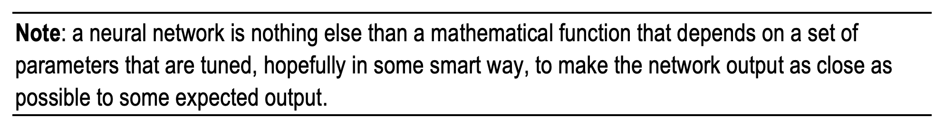
An intuitive definition of learning
What does it mean “as close as possible”?
We need a mathematical way of measuring “closeness”
U. Michelucci, Applied Deep Learning with TensorFlow 2, Springer Nature, 2022

Slide 4
An intuitive definition of learning
Loss Function
Optimiser
Neural Network Architecture
U. Michelucci, Applied Deep Learning with TensorFlow 2, Springer Nature, 2022

Slide 5
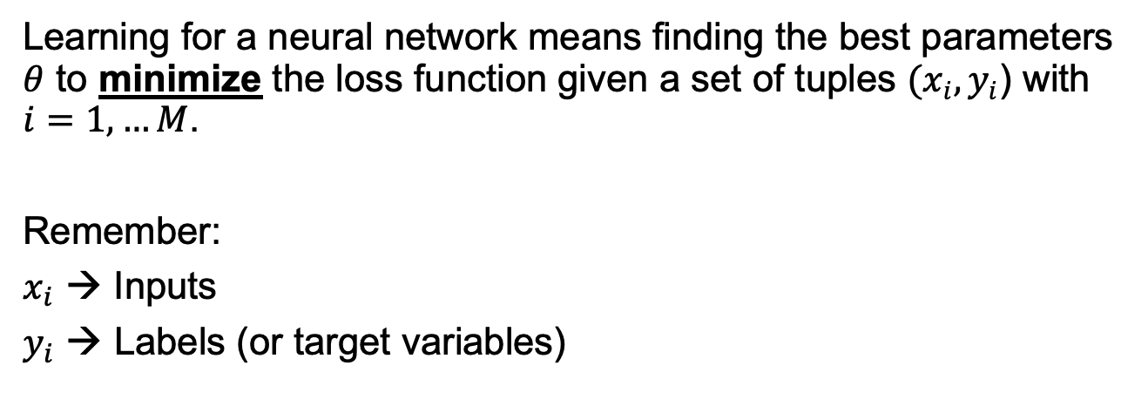
Learning in the context of neural networks
Learning for a neural network means finding the best parameters $θ$ to minimize the loss function given a set of tuples $(x_{i}, y_{i}$) with $i=1,…M$.
Remember:
$x_{i}$ → Inputs
$y_{i}$ → Labels (or target variables)
A mathematical formula
to measure “closeness”

Slide 6
The 3 main components of a neural network model
The neural network architecture (type of network, number of layers, etc.)
The loss function (the one we want to minimise)
The optimiser (the algorithm to find the minimum of the loss function)

Slide 7
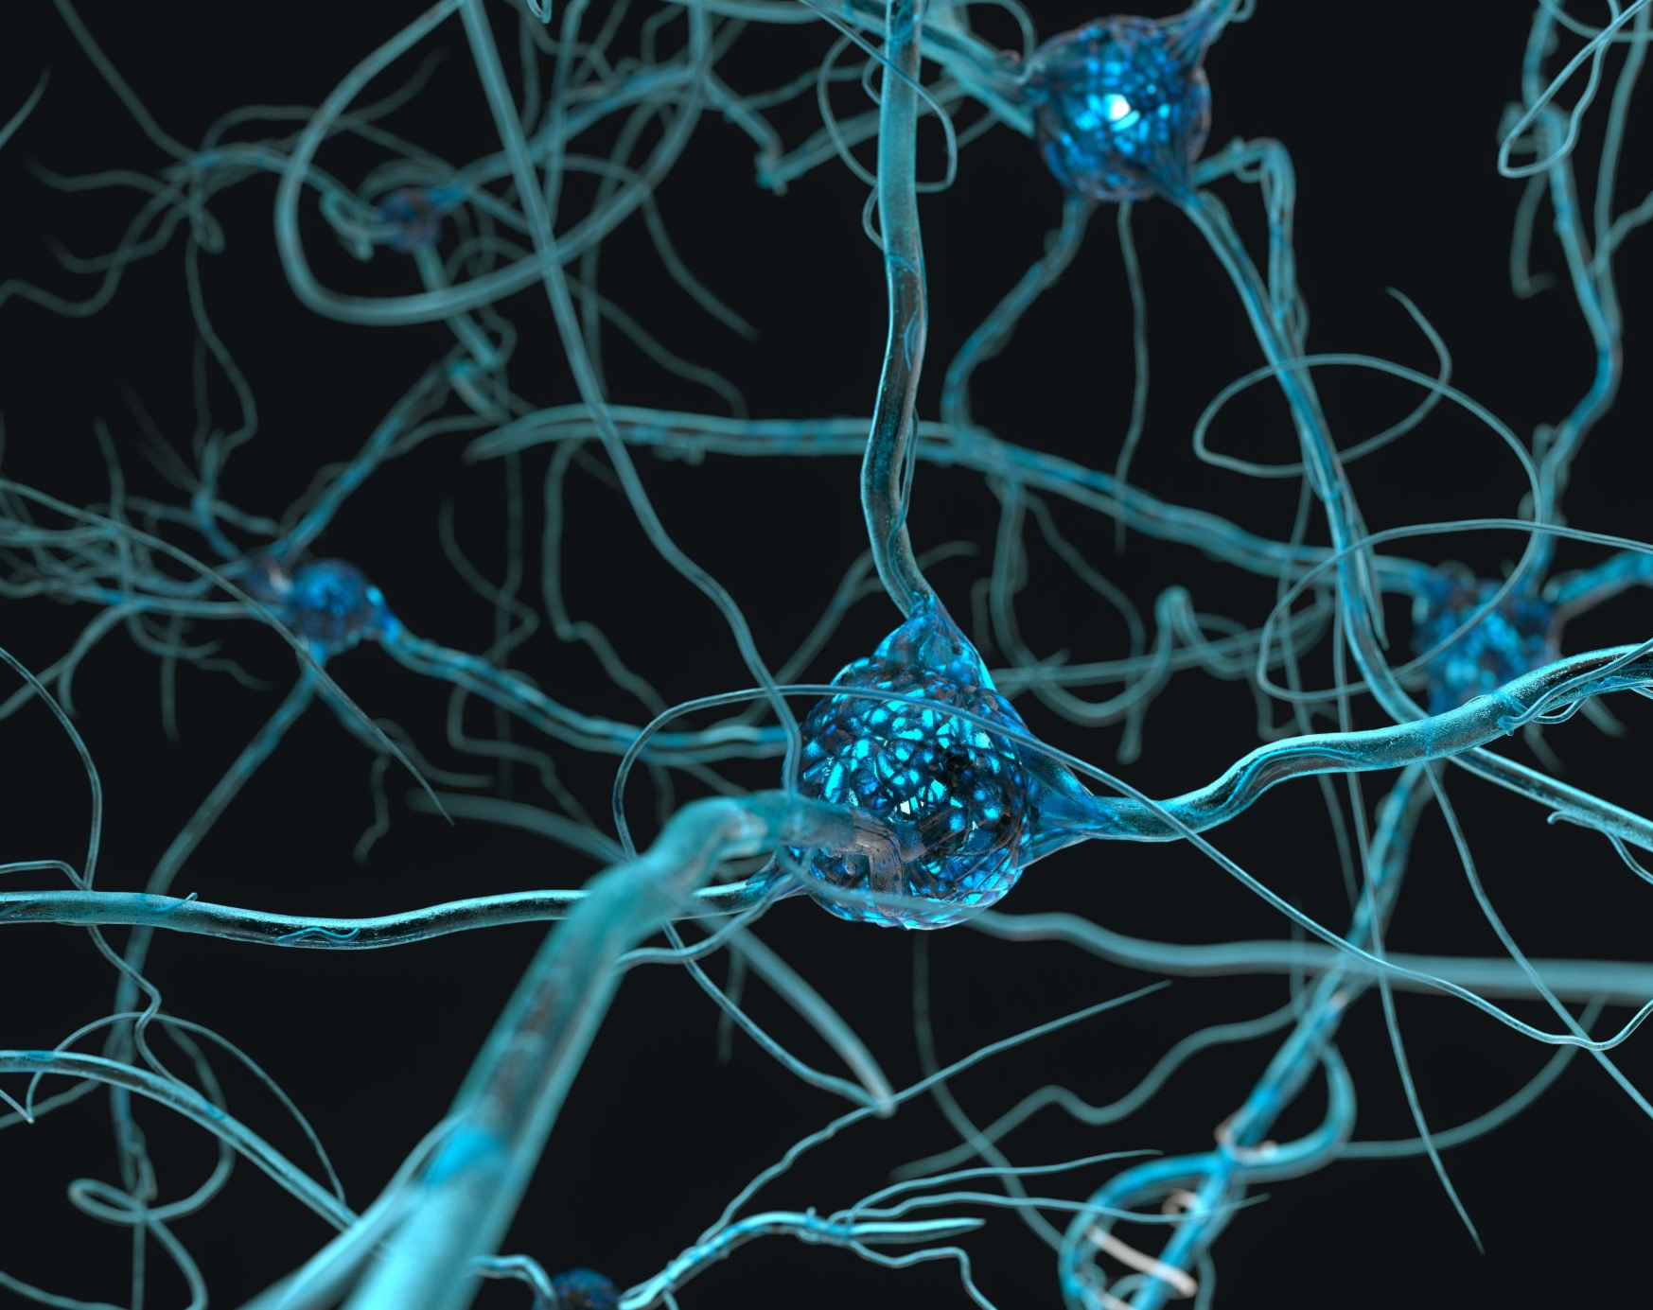
Structure of a neuron

Slide 8
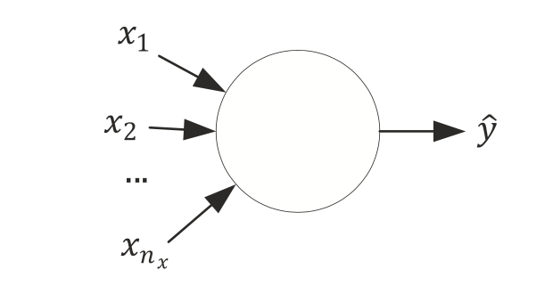
A neuron without details

Slide 9
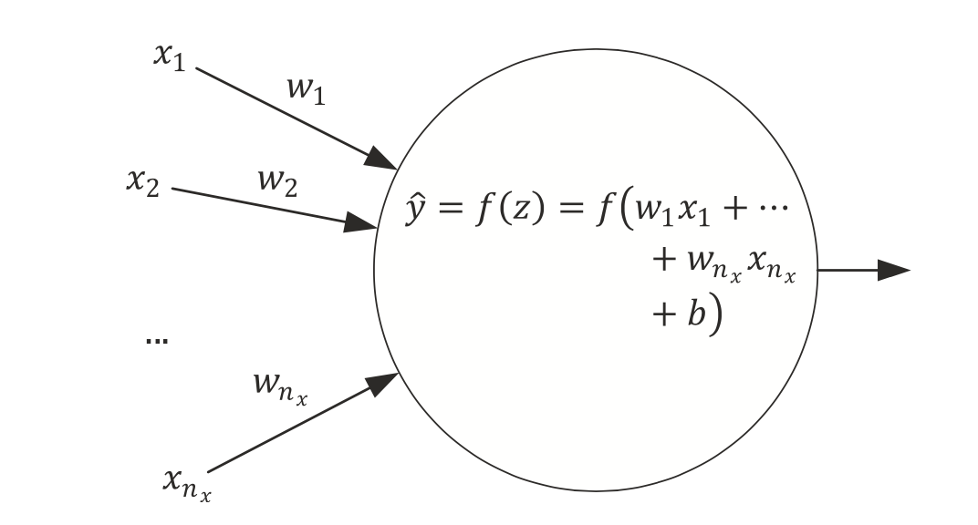
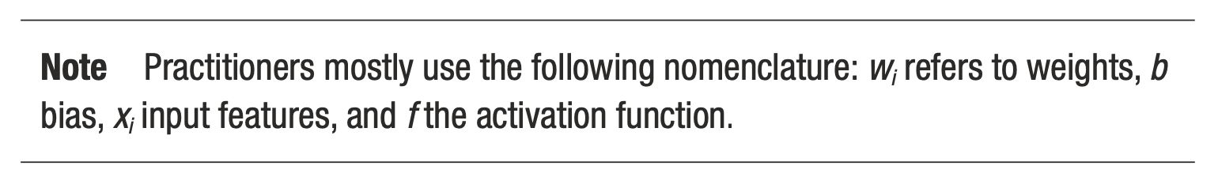
Simplest network possible
The simplest neural network that we can create is made of one single neuron.
Source:Umberto Michelucci, Applied Deep Learning - A Case-Based Approach to Understanding Deep Neural Networks, APRESS 2018

Slide 10
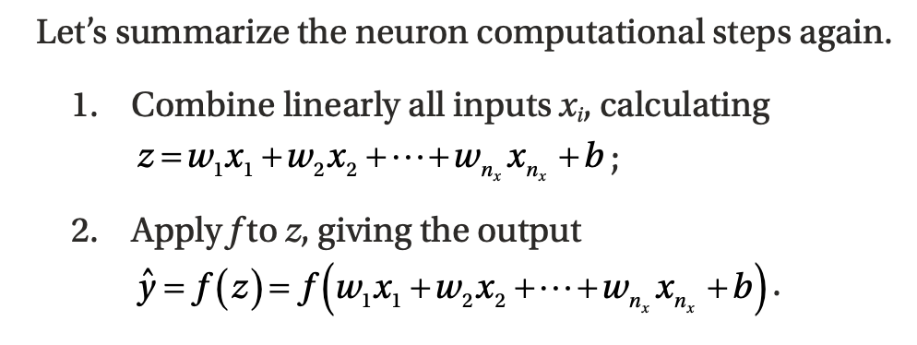
Computational Steps of a single neuron
Weights
Bias
Activation Function
Source:Umberto Michelucci, Applied Deep Learning - A Case-Based Approach to Understanding Deep Neural Networks, APRESS 2018

Slide 11
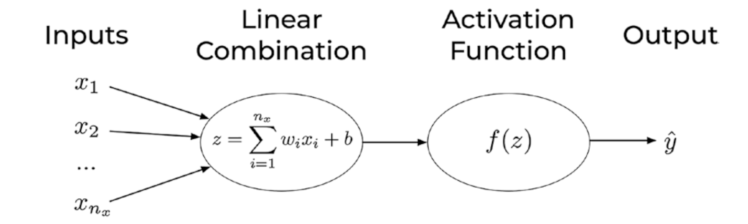
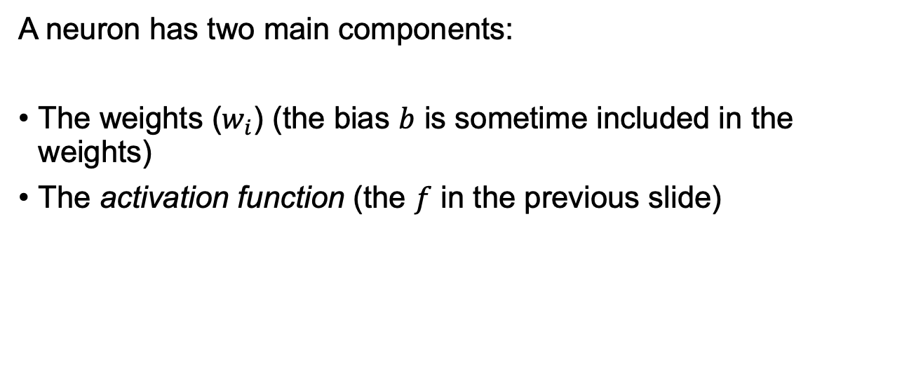
Components of a neuron
A neuron has two main components:
The weights ($w_{i}$) (the bias $b$ is sometime included in the weights)
The activation function (the $f$ in the previous slide)
U. Michelucci, Applied Deep Learning with TensorFlow 2, Springer Nature, 2022

Slide 12
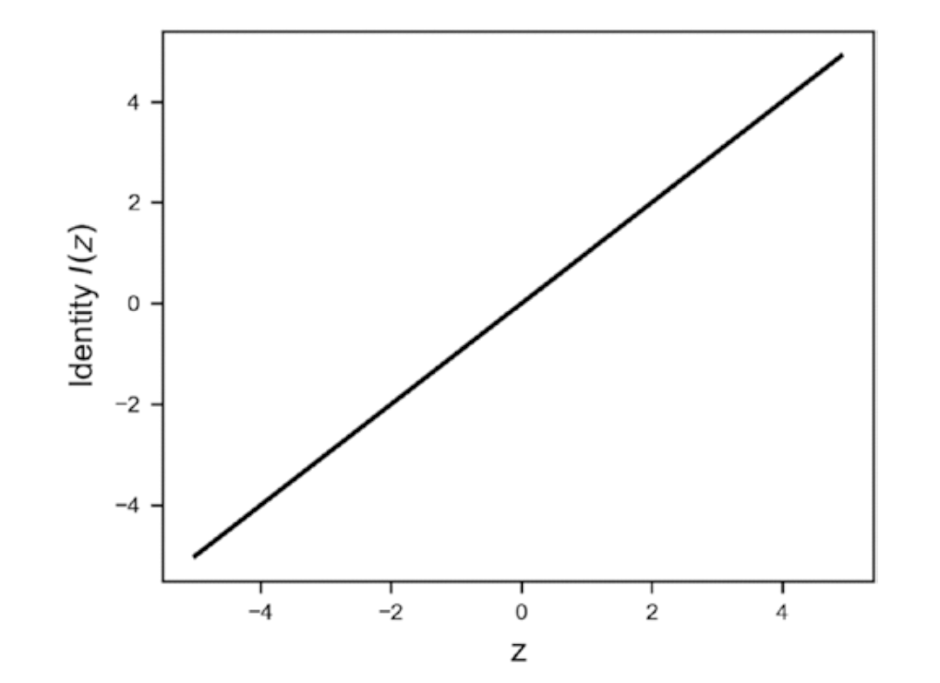
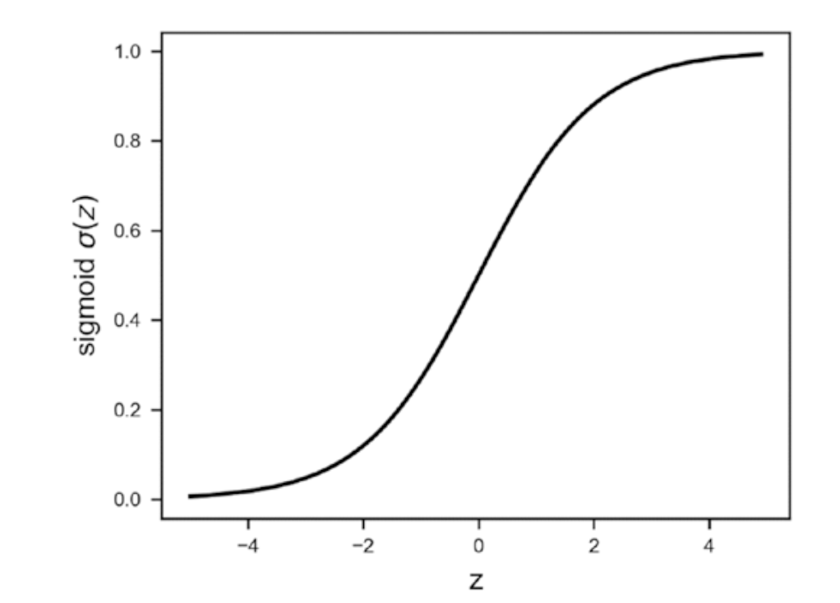
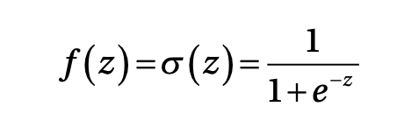


Activation Functions ($f(z)$)
Identity
Sigmoid
U. Michelucci, Applied Deep Learning with TensorFlow 2, Springer Nature, 2022

Slide 13
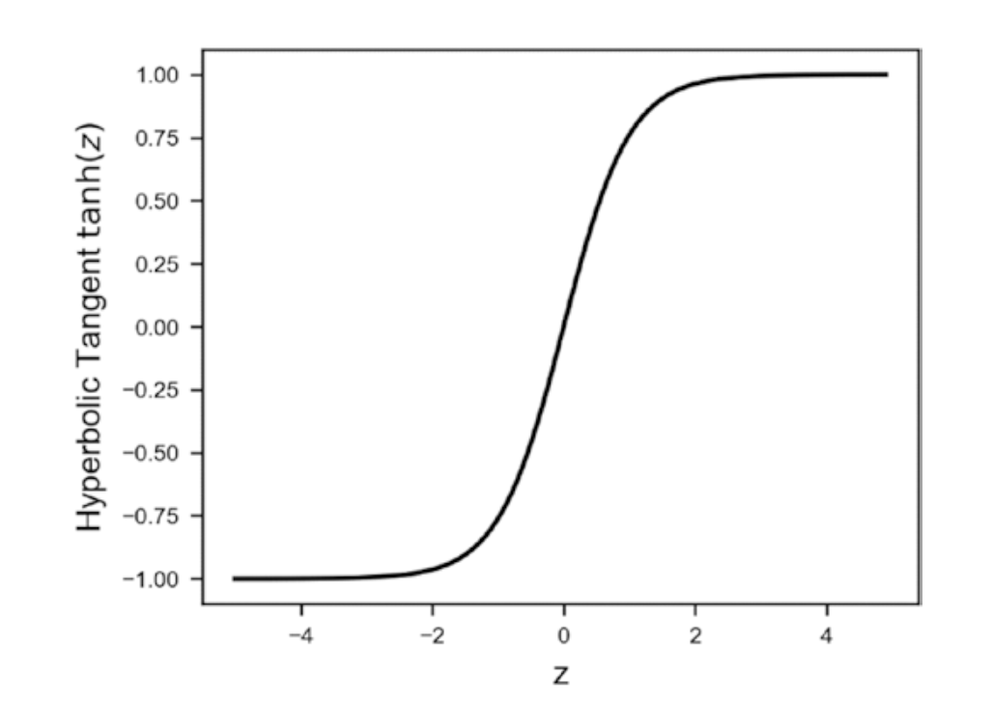
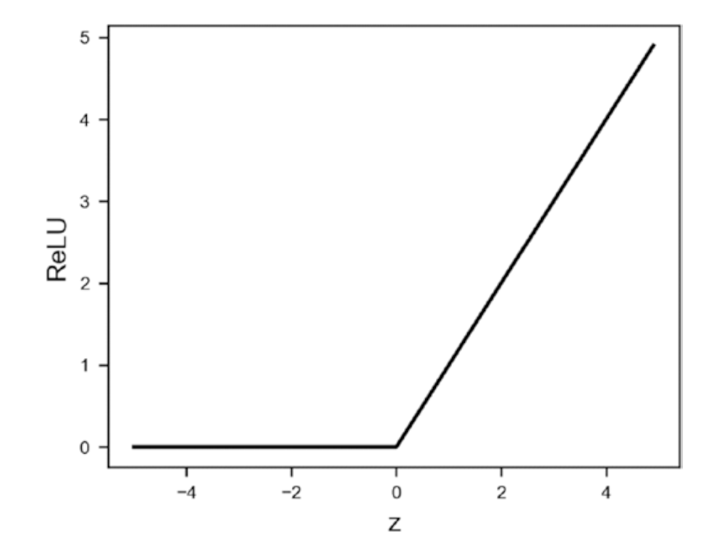
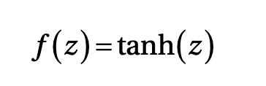

Activation Functions ($f(z)$)
Hyperbolic Tangent
ReLU (Rectified Linear Unit)
U. Michelucci, Applied Deep Learning with TensorFlow 2, Springer Nature, 2022

Slide 14
Activation Functions ($f(z)$)
Many others:
Leaky ReLU
Swish
ArcTan
Exponential Linear Unit (ELU)
Softplus

Slide 15
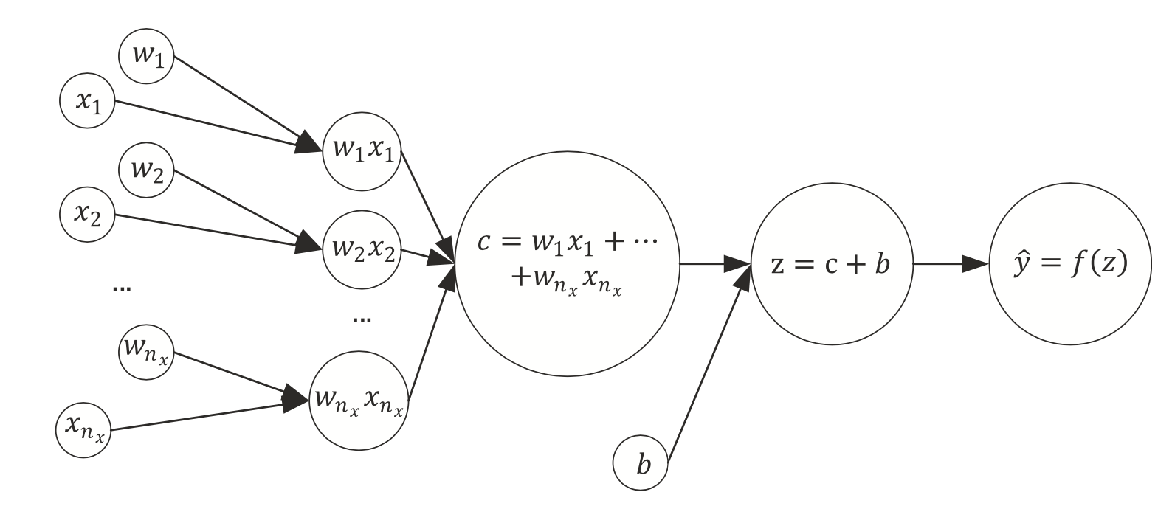
The same network seen as a computational graph
A computational graph is a directed graph where the nodes correspond to operations or variables. Variables can feed their value into operations, and operations can feed their output into other operations. This way, every node in the graph defines a function of the variables. (From: http://www.deepideas.net/deep-learning-from-scratch-i-computational-graphs/)
Source:Umberto Michelucci, Applied Deep Learning - A Case-Based Approach to Understanding Deep Neural Networks, APRESS 2018

Slide 16
What is a tensor (why TensorFlow?)
In its simplest (and somehow incorrect) definition a Tensor is simply a multi-dimensional array of numbers.
An image is a tensor of 3-dimensions (the horizontal and vertical resolution and the colors, RGB).

Slide 17
Learning for a neuron includes 3 components
A neural network (defined by its architecture, in other words the computational steps to evaluate the network output)
A loss function (a function to measure how good or bad the network is predicting the outputs)
An algorithm to minimize the loss function (also called optimizer)
Source:Umberto Michelucci, Applied Deep Learning - A Case-Based Approach to Understanding Deep Neural Networks, APRESS 2018

Slide 18
Quiz: What can a neuron do?
We have discussed how a neuron looks like. But how can a neuron solve any type of problem?
Can a neuron solve a classification and a regression problem? How can we do that?
Question to you: which component of a neuron is responsible for the type of problem we want to solve?
Notes:
Draw on the blackboard all the components of a neuron and the 3 components of a model and ask students which part is relevant

Slide 19
Which portion of a neural network model is responsible for the type of problem that can be solved?
Two main components are responsible for the type of problem that can be solved:
The output activation function
The loss function
→ The optimiser is not related in any way to the type of problem solved.

Slide 20


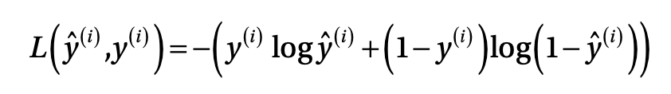

A single neuron can do a lot
Logistic regression (binary classification)
Linear regression

Slide 21
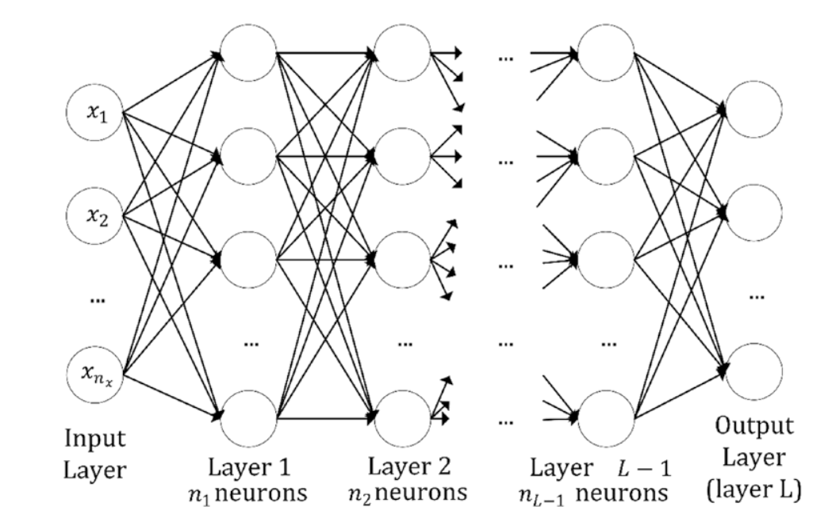
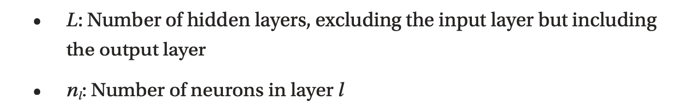
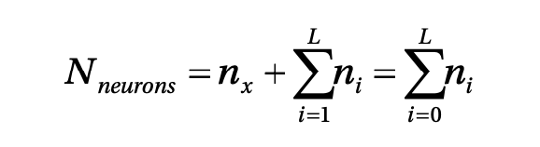
Multiple neurons / multiple layers
Layer (no intra-layer connection)
Quiz: Do you think there is any rule or best practice in deciding how many neurons/layers you should use?
Source:Umberto Michelucci, Applied Deep Learning - A Case-Based Approach to Understanding Deep Neural Networks, APRESS 2018

Slide 22
How to do classification if the output is a real number?

Slide 23
Classification Problem and output activation function The Softmax function

Slide 24
Neural Network Architecture (example with 3 classes)
How should we interpret those numbers?
We would like to interpret them as the probability of the input observation to be in class 1, 2 or 3.
Network
Input

Slide 25
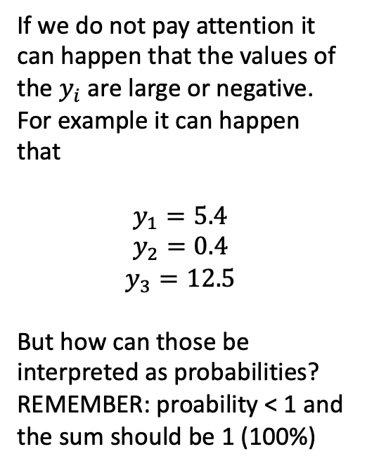
Neural Network Architecture (example with 3 classes)
If we do not pay attention it can happen that the values of the $y_{i}$ are large or negative. For example it can happen that
$$y_{1}=5.4$$
$$y_{2}=0.4$$
$$y_{3}=12.5$$
But how can those be interpreted as probabilities? REMEMBER: proability < 1 and the sum should be 1 (100%)
Network
Input

Slide 26

Neural Network Architecture (example with 3 classes)
$$y_{1}=5.4$$
$$y_{2}=0.4$$
$$y_{3}=12.5$$
Network
Input

Slide 27
Neural Network Architecture (example with 3 classes)
Network
Function
Input

Slide 28

Neural Network Architecture (example with 3 classes)
$$z_{1}=\frac{e^{y_{1}}}{e^{y_{1}}\text{+}e^{y_{2}}\text{+}e^{y_{3}}}$$
$$z_{2}=\frac{e^{y_{1} }}{e^{y_{1}}\text{+}e^{y_{2}}\text{+}e^{y_{3}}}$$
$$z_{3}=\frac{e^{y_{1}}}{e^{y_{2}}\text{+}e^{y_{2}}\text{+}e^{y_{3}}}$$
Function

Slide 29
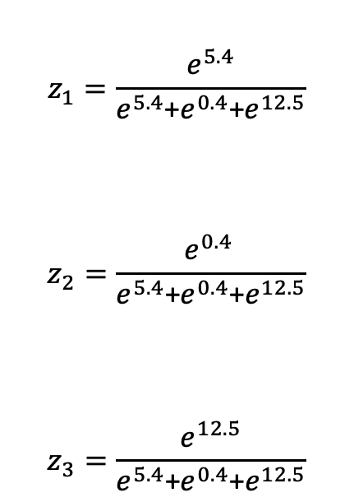
Neural Network Architecture (example with 3 classes)
$$z_{1}=\frac{e^{5.4}}{e^{5.4}\text{+}e^{0.4}\text{+}e^{12.5}}$$
$$z_{2}=\frac{e^{0.4 }}{e^{5.4}\text{+}e^{0.4}\text{+}e^{12.5}}$$
$$z_{3}=\frac{e^{12.5}}{e^{5.4}\text{+}e^{0.4}\text{+}e^{12.5}}$$
Function

Slide 30

Neural Network Architecture (example with 3 classes)
$$z_{1}=0.08\%$$
$$z_{2}=5.5⋅{10}^{−6}$$
$$z_{3}=99.91\%$$
Function

Slide 31
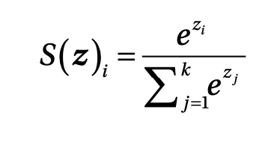
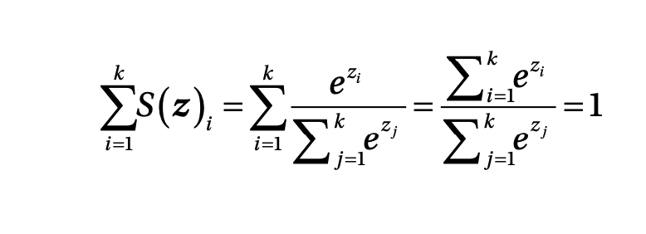
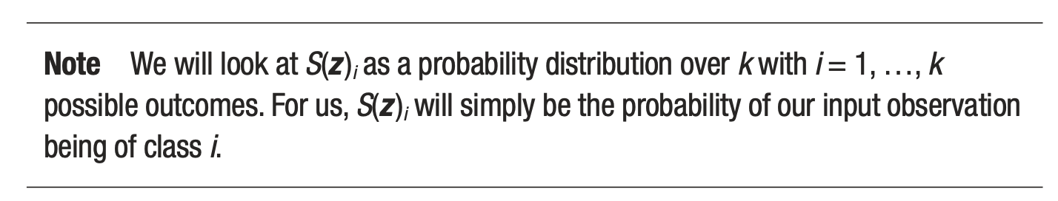
Softmax output layer for classification
Output of ith neuron of the output layer
Note that they can be interpreted as probability since the sum is equal to 1
Source:Umberto Michelucci, Applied Deep Learning - A Case-Based Approach to Understanding Deep Neural Networks, APRESS 2018

Slide 32
Challenges with Neural Networks

Slide 33
Additional difficulties
Regularisation – How to avoid overfitting and make the models generalize better
Hyperparameter tuning - finding the best parameters to obtain the best values for the chosen metric
Metric analysis - detecting possible issues with the datasets
Training speed - optimizing to get the fastest training possible
Big datasets - working with amount of data that does not fit in memory anymore

Slide 34
Additional architectures
There are many architectures that are know to work best with different data types:
Convolutional neural networks: for multi-dimensional data types (as images)
Recurrent neural networks: time series, language, etc.
Many others have been developed to solve specific problem as: object localisation, segmentation (in MRI for example), etc.

Slide 35
From here the only limit is your creativity!

